Slide 1





Digital Twins: Virtual Replicas of Real-World Systems
Presented To,
Shah Md. Tanvir Siddique
Assistant Professor
Department Of CSE
Course Title : Compiler Design
Course Code : CSE 313
Presented By,
S M Sadman Al Siam 0242310005101123
Tanbir Hasan Jewel 0242310005101178
Meheruba Binte Kashem Anti 0242310005101157
Mosabbir Hossen Maruf 0242310005101182
Md.. Nazmul Islam 0242310005101183

Slide 2

Digital Twins: Virtual Replicas of Real-World Systems
Bridging the Physical and Digital Worlds for Unprecedented Insight and Control.

Slide 3


What Is a Digital Twin?
A digital twin is a dynamic, virtual replica of a physical object, system, or process that updates in real time.
Real-time Mirroring
Dynamic Evolution
Mirrors behavior, performance, and environment using live data from sensors and IoT devices.
Unlike static 3D models or simulations, digital twins evolve alongside their physical counterparts.

Slide 4




The Technology Behind Digital Twins
IoT Sensors
Cloud Computing
Collect real-time data from physical assets.
Enables scalable data storage and processing.
AI & Machine Learning
Spatial Computing
Analyze data for insights and predictions.
Integrates 3D, geospatial, and temporal data for immersive models.

Slide 5

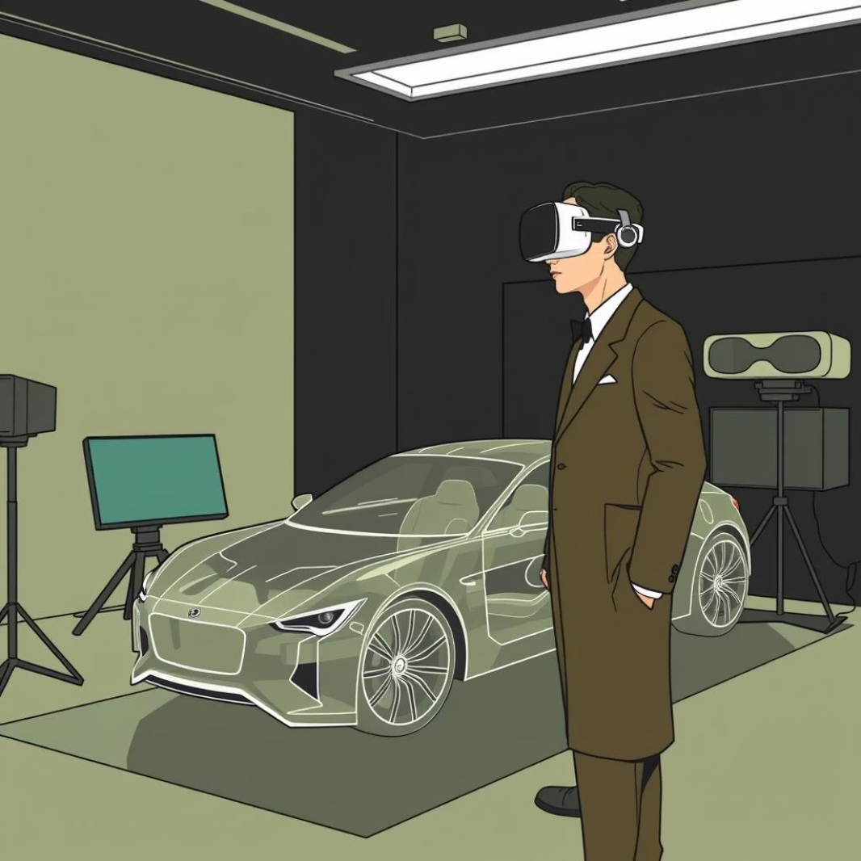





Digital Twins vs. Simulations and Virtual Twins
Simulations
Virtual Twins
Digital Twins
Generic, model-based scenarios without real-time data linkage, primarily for testing hypothetical situations.
Simulation-focused, used for testing designs before real-world deployment, emphasizing design validation.
Real-time, data-driven replicas connected to actual physical assets for ongoing monitoring and optimization.

Slide 6



Four Types of Digital Twins
1
Component Twin
2
Product Twin
Replicates individual parts for detailed monitoring,
like a specific engine sensor.
Represents whole products through their lifecycle,
such as an entire vehicle.
3
System Twin
4
Process Twin
Models interactions of multiple components,
like a complex assembly line.
Integrates systems to simulate entire operations, optimizing end-to-end workflows.

Slide 7








Real-World Applications: Industry Transformations
Manufacturing
Smart Cities
Predictive maintenance reduces downtime by forecasting failures, ensuring continuous operation.
Urban planners optimize traffic, energy, and disaster response for sustainable living.
Healthcare
Energy
Personalized digital twins simulate patient treatments and optimize care delivery.
Utilities monitor grids and wind farms to improve efficiency and prevent outages, ensuring reliable power.

Slide 8


Dramatic Impact: Market Growth & Adoption
Digital twins are rapidly transforming industries, leading to substantial market growth and widespread adoption among leading enterprises.
$73.5B
60%
70%
25%
Market Projection
Annual Growth
Executive Investment
Efficiency Gains
McKinsey projects digital twin market to reach $73.5 billion by 2027.
Expected annual growth rate of the digital twin market.
C-suite tech executives investing in digital twins at large enterprises.
Reported operational efficiency gains after deploying digital twins.

Slide 9
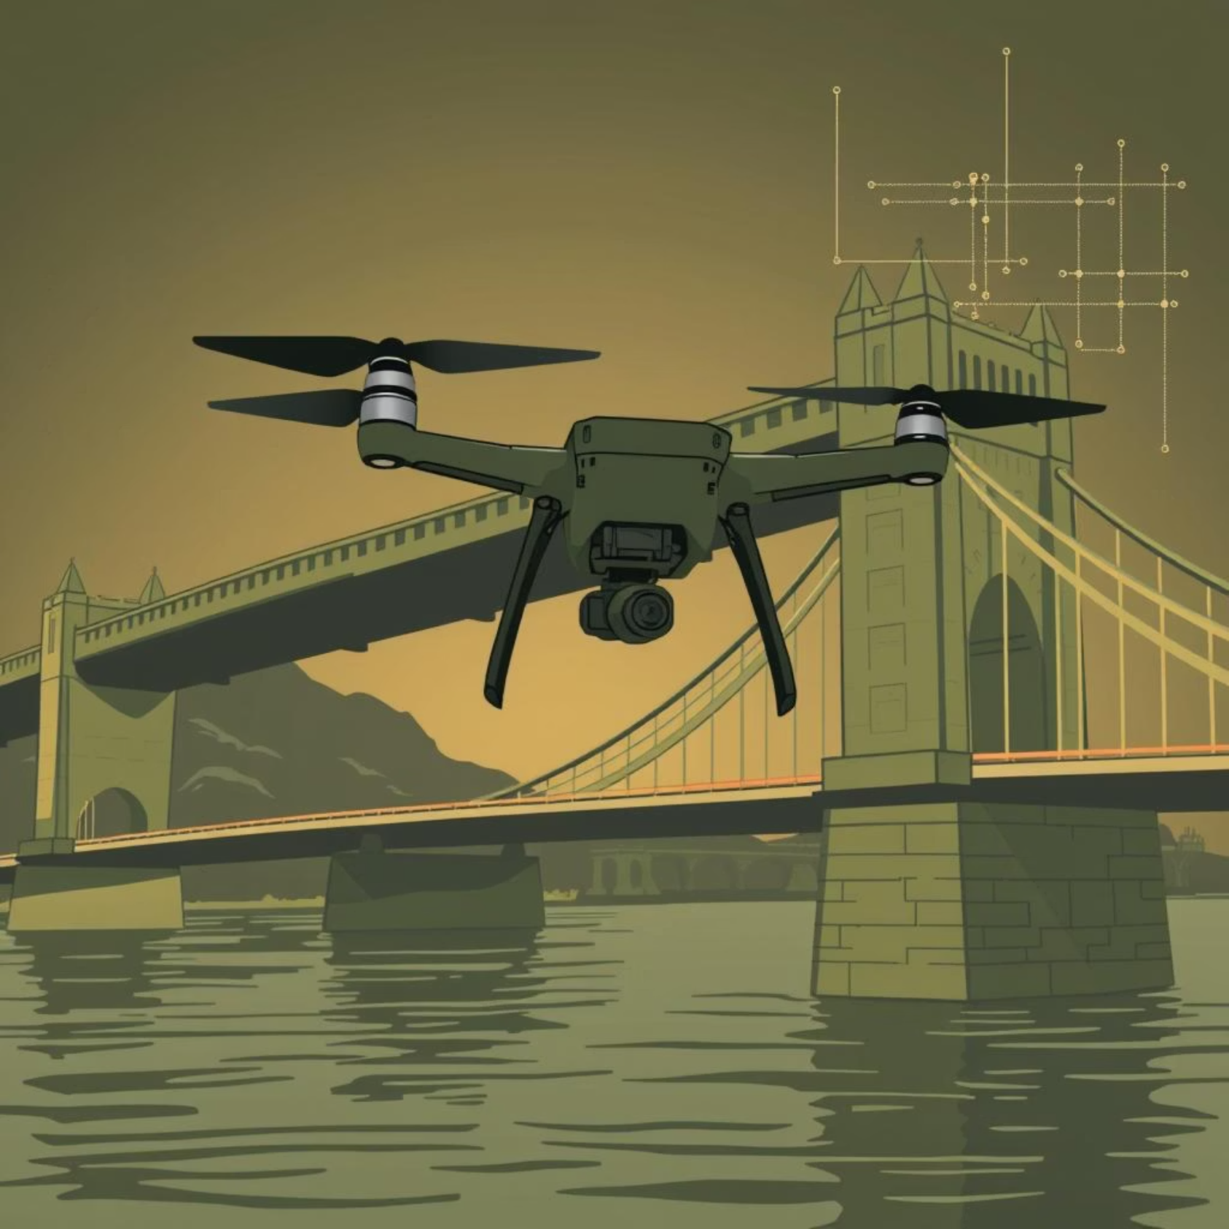
Case Study: Cincinnati’s Digital Bridge Inspection
Over 150-year-old bridges carrying 100,000+ vehicles daily.
Drone-enabled digital twins reduced inspection time from months to minutes.
Real-time issue detection and virtual reality review accelerated repairs and safety.

Slide 10

The Future: AI-Enhanced, Synthetic Data & Personalized Twins
The evolution of digital twins will be driven by advanced AI, innovative data approaches, and immersive visualization.

Slide 11
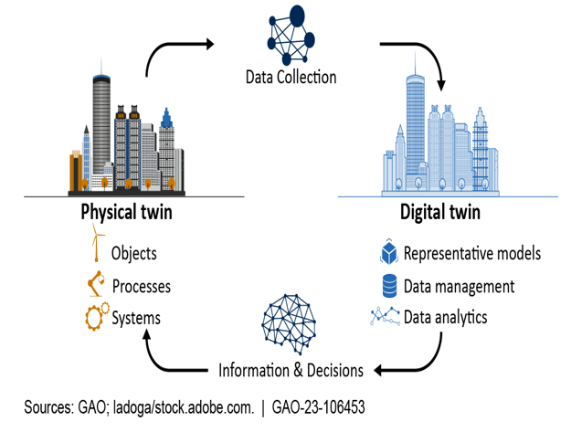
Challenges and Limitations
Developing accurate and reliable digital twins requires high-quality data and infrastructure.
Integrating digital twins into existing systems can be complex and costly.
Ensuring data security and privacy is critical when handling sensitive operational information.

Slide 12

Conclusion: Unlocking Value with Digital Twins
Digital twins bridge physical and digital worlds to drive innovation, efficiency, and safety.
They empower smarter decisions, reduce costs, and accelerate product and process development.
The future belongs to organizations that harness digital twins to transform complexity into clarity.
Embrace digital twins to revolutionize your operations and gain a competitive edge!

Slide 13
THANK YOU

